Slide 1

Problems on Conditional Expectation 2015

Slide 2
Reference
Data
Youtube
Code

Slide 3
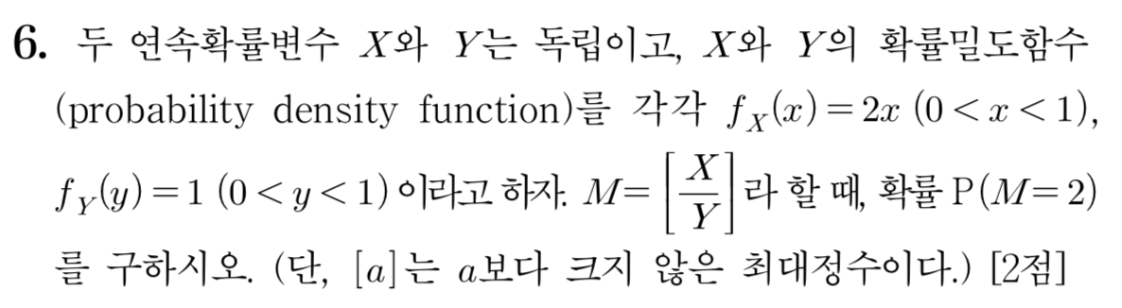
[2015]

Slide 4
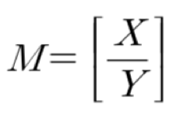

Slide 5
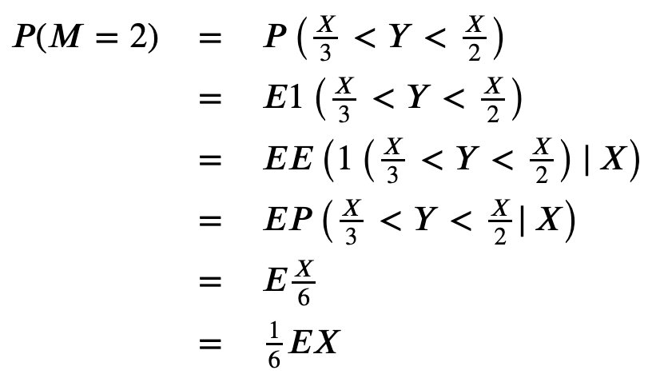


Slide 11


Slide 12
